Slide 1
MQTT-CoAP Exercise (Part 2)
Course 34351 Access- and Home Networks

Slide 2
MQTT-CoAP exercise
The MQTT-CoAP exercise is the second of the mandatory exercises in course 34351
Takes place over three consecutive weeks:
Date | Topic
2025-03-13 | Introduction to the exercise, Exercise Part 1 (MQTT)
2025-03-20 | Exercise part 2 (CoAP) ⬅ TODAY!
2025-03-27 | Exercise wrap-up if there are parts you’re missing – otherwise work on your journal
2025-04-03 | Deadline for handing-in the journal to the assignment on DTU Learn @13:00

Slide 3
MQTT-CoAP exercise (2)
Hand-in of reports: Individually or in groups of 2-3 students
Deadline: Wednesday, April 3 at 13:00
You have to join a group on Learn to be able to hand-in
  Even if you work individually (i.e., if you’re a one-person “group”)
    It can be the same group as for the Mininet-WiFi exercise - or a new group if you wish
  Go to My Course => Groups on Learn
    Find an empty group (“0/3 members”)
    Click on group to join (should be done by both of you for two-person groups)
  Contact me if you have trouble with groups

Slide 4
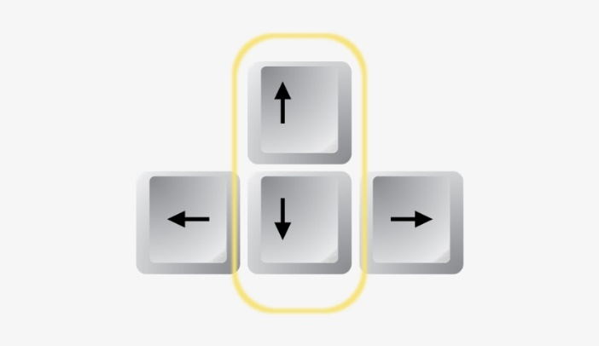
General tips
Saving output from Linux commands/scripts:
  Linux CLI: command 2>&1 | tee outputfile.txt
Use the up and down arrow keys on your keyboard to
quickly scroll up and down in your command history

Slide 5
Virtual networks in Linux for the CoAP part
Network namespaces are used to create a virtual network for the exercise:
  Scripts in the /home/user/coap directory
  In a terminal: cd coap
netgenerate.sh - Generates a virtual network
  sudo ./netgenerate.sh --ipv6
    Generates the virtual network on the right
    and opens an Xterm window on each host
    Note: IPv6 addresses!
clearnet.sh - Deletes the virtual network
  Execute: sudo ./clearnet.sh

Slide 6
CoAP software
CoAP software used: libcoap
  URL: https://libcoap.net
Mainly a library, but includes programs for servers and clients that are ideal for experimenting with (like we do!)
Program documentation:
  Server: https://libcoap.net/doc/reference/4.3.4/man_coap-server.html
  Client: https://libcoap.net/doc/reference/4.3.4/man_coap-client.html

Slide 7
Assignment
Go through the steps of the MQTT-CoAP exercise documents on Learn
  MQTT was the focus of Part 1 (last week)
  CoAP is the focus of Part 2 (today!)
Write an lab journal where you answer the questions in the manual
  You don’t need to write a loooooong novel for each part
  But your answers must be documented!
Hand-in the complete lab journal on Learn no later than April 3 @13:00

